Slide 1
Do you know your church?
African methodist episcopal church
general board information session
Keith W. Coston Jr., General Board Member

Slide 2
What is the general board?
The General Board is the Administrative arm of the african methodist episcopal church, working with and on behalf of the board of incorporators and the council of bishops.

Slide 3
General Conference
General Conference Commission
Judicial Council
Board of Incorporators
Council of Bishops
General Officers
General Board
Department of Churches
Commissions of the Board
Annual Conference
District Conference
Quarterly Conference
Church Conference
(Local)
ORGANIZATIONAL SRUCTURE OF
GENERAL & CONNECTIONAL DIVISIONS
Notes:
General Conference is the supreme body of the AME Church. Composed of Bishops, lay and ministerial delegates, General Officers, College Presidents & Deans of Theological Seminaries.
General Conference Commission consists of 4 bishops nominated by the council of bishops and elected by the General Conference. 2 representative from each district, one lay and one clergy. Six at large representatives (3 lay and 3 ministers – 1 must be a young adult. They must be nominated at the General Conference. The General Secretary and the Chief Financial Officer.
Judicial Council – The highest judicatory body of the AME Church.
Board of Incorporators – General Board of Trustees of the AME Church. Supervision, In Trust, of ALL Connectional Church property. This body has the authority to act on or behalf of the connectional church.
Council of Bishops – The executive branch of the connectional church which has general oversight of the church during the interim of General Conferences.

Slide 4
The genesis of the general board

Slide 5
IT STARTED largely because of THIS
Notes:
Does anybody know what this is?
Have you ever heard of the Dollar Money System?
The Dollar Money System was a funding formula for the AME Church.
This name is applied to the annual one dollar which each pastor was required to collect from or for each member of his church and report to the annual conference.
It was originated in 1872 when the finance department started. The division of the dollar was as follows……. 8cents – Church Extension, 8 cents – Missionary Department, 8 cents to the Educational Department, 36 cents – Annual conference appropriations, 40 cents – Finance Department.

Slide 6
IMPORTANT NOTES
”The BROTHERHOOD”
1956
General Conference
“Four & No More”
Notes:
In 1940 a “talented tenth” of leading misters determined that the denomination badly needed internal change relating to improved election procedures, greater fiscal accountability and more efficiency in operating AME Schools.
Brotherhood – A group known as the “Brotherhood” made up of both clergy and lay in the 1950’s challenged the Dollar Money System in favor of a better funding formula. This group committed to establish a budget system to eliminate financial irregularities and misappropriations and to insure that sufficient monies were available to operate denominational ministries and departments.
In 1956 at the General Conference in Miami, Florida H. Ralph Jackson, a pastor from the 13th District motioned “that business methods make it imperative that we have a budget to cover all connectional moneys or expenditures. The general conference should direct the revisions committee and the Temporal (economy) Committee to prepare a budget that will include all necessary items for the General Church. Ultimately during that General Conference, due to the Brotherhood strategy a bill establishing a General Board was enacted.
The legislation mandated that there shall be established a central fund in the AME Church and it shall be known as the General Budget Fund that embraced 17 areas.
Episcopal Fund, Administration Fund (Laymen’s Activities), Minimum Salary Fund, Publication Fund, Conference Benevolence Fund, Interdenominational Cooperation Fund, Episcopal District Projects Fund, Evangelism Fund, Historiographer Fund, Secretary AME Church Fund, Pension Fund, Mission Fund, Church Extension Fund, Women’s Missionary Fund, Religious Education Fund, Educational Institute Fund & Reserve.
To Fund these activities the General Conference shall apportion the amount of the General Budget Fund to the various Episcopal Districts. When the amount has been allocated, it shall represent the total assessment upon an Episcopal District, Annual Conference, and local church for connectional and episcopal district operation. The power of assessment shall lie with the General Conference only.
It became the duty of the General Board to monitor the connectional budget and audit all accounts.
The agreed assessment on AME members to fund the new system became $4.00 per member. The amount became insufficient and there were denominational shortfalls.

Slide 7
THE role of the general board

Slide 8
Composition of the General board
Active bishops of the church
Executive directors of various departments
Treasurer/chief financial officer
General secretary/chief information officer
5 Representatives from each episcopal district
Even numbered districts shall be represented by 3 minsters and 2 lay members.
Odd numbered districts shall be represented by 2 ministers and 3 lay. (2016-2020 Quaredrennium)
At least one member of every episcopal district shall be a young adult between the ages of 18-35.
The clergy/laity representation rotates annually

Slide 9
Composition of the General board
The council of Bishops shall nominate ten persons to serve at-large, at least one of whom shall be a young adult between the ages of 18-35.
The heads of departments and institutions receiving funds from the general budget shall be ex officio members. They shall sit with the board in its meetings and have the right of the floor without the privilege of making motions or voting.

Slide 10
Officers of the general board
President – Bishop Gregory G.M. Ingram
14 Vice Presidents,
each serving as chairperson of the standing commissions

Slide 11
Commissions of the general board
Statistics & Finance
Retirement services
Publications
Social action
Church growth & Development
Global witness & ministry
Lay organization
Seminaries, colleges, universities and Schools
Christian education
Women in ministry
Health
Ministry & recruitment
Global development
Economic development

Slide 12
Nominating committee
Composed of 8 persons that shall be elected by individual secret ballot for each quadrennium.
Four members shall be clergy and four members shall be laypersons.
At least one member shall be a young adult between the ages 18-35.
The committee shall nominate the officers of the general board and members for each standing commission.
These persons so nominated by the committee shall be elected by secret ballot by the members of the board.
The president of the general board shall be elected biennially and shall not succeed himself/herself in office. In no case shall the president of the general board BE THE PRESIDENT OF THE COUNCIL OF BISHOPS.

Slide 13
vacancies
WHEN A VACANY OCCURS ON THE GENERAL BOARD BEWTEEN SESSIONS OF THE GENERAL CONFERENCE, THE PRESIDING BISHOP OF THE EPISCOPAL DISTRICT IN WHICH THE VACANCY OCCURS SHALL NOMINATE A REPLACEMENT WHO MUST BE VOTED UPON BY THE GENERAL BOARD.

Slide 14
Executive committee
There shall be an executive committee of the general board, consisting of the officers of the board and and one representative from each episcopal district.
Even numbered districts shall furnish the ministerial representatives and odd numbered districts shall furnish the lay representatives on the executive committee. The order of ministerial and lay representation shall rotate each quadrennium.
No action of the executive committee shall be final until approved by the general board.
The executive committee shall meet at the call of the chairperson or a majority of the membership and shall act for the general board. The committee shall not take any action contrary to or in conflict with any policy of the general board.
The general board has the authority to reverse any action of the executive committee on a majority vote.

Slide 15
Standing commissions
THE GENERAL BOARD THORUGH ITS STANDING COMMISSIONS IN ITS DISCRETION MAY GIVE ADVICE OR INSTRUCTION, AMEND AND PASS UPON THE MANAGEMENT AND CONDUCT OF ANY AND ALL GENERAL AND CONNECTIONAL OFFICERS.
Regular MEETINGS
RESpONSIBILITIES
Notes:
However, the board should not interfere with the orderly procedure of the respective officer in the discharge of his/her duties except in any case when they may be found incapable of discharging their office or be found guilty of an offense which would render them unworthy to continue in office.
Regular Meetings – All regular meetings of the standing commissions and board shall be held at the same site and in the same week as one of the meetings of the Council of Bishops and the Connectional Council. Commission meetings should not exceed 2 hours and devotions should honor a 15 minute maximum length of time.

Slide 16
DUTIES OF THE GENERAL BOARD
There Are A List of duties Outlined in the doctrine & discipline of the african methodist episcopal church.

Slide 17
Rules of the general board
The General Board’s operation is based on a set of rules that have been developed with generally accepted interpretations and constructions of our established polity, customs, tenets, and traditions of African Methodism.
Notes:
There are 21 rules that rules that govern the General Board.

Slide 18
Financial considerations

Slide 19
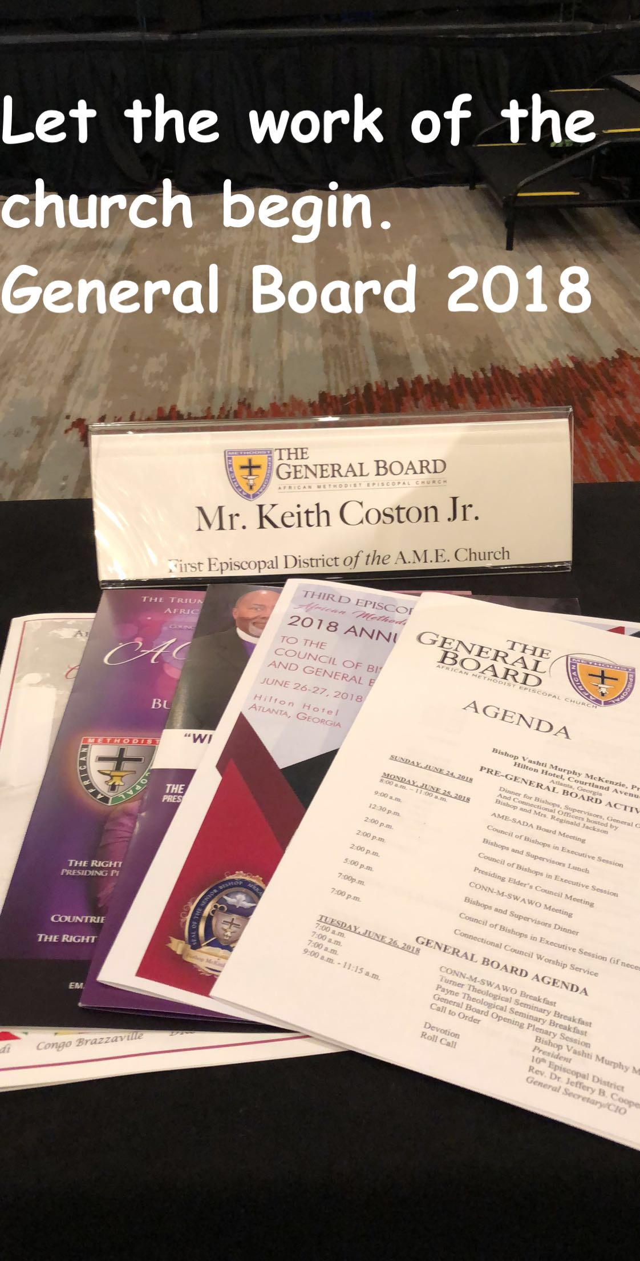
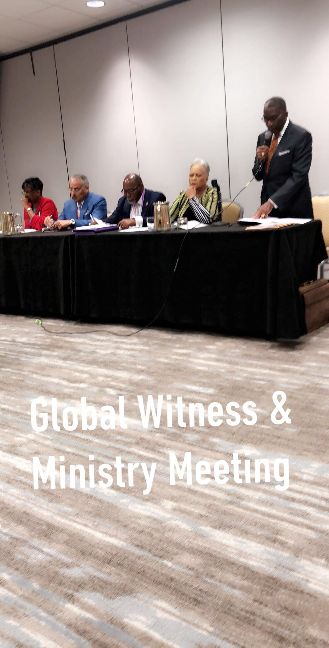
My Experiences
CHICAGO, IL - 2016 LOS ANGELES, CA – 2017
ATLANTA, GA – 2018
BIRMINGHAM, AL –2019

Slide 20
QUESTIONS????

